Slide 1


Salon Website
Subject: Python and Web Programming (202045612)
Name : Aryan Prajapati (12202130501005)
Branch : Computer Science Design
Academic Year : 2024-25

Slide 2
INTRODUCTION
The Seven Star Salon website is a user-friendly platform that displays salon services and makes it easy for clients to book appointments and manage their profiles.
With a simple design, secure login, and personalized options, it improves the overall salon experience for users.

Slide 3
TECHNOLOGIES USED
Django (Backend)
Purpose: Django is a robust, secure web framework that handles the back-end operations, database management, and server-side functionality of the application.
Efficiency : Django’s ORM and admin interface save development time, while CSS and JavaScript libraries (such as Bootstrap or jQuery, if used) enhance front-end efficiency.

Slide 4
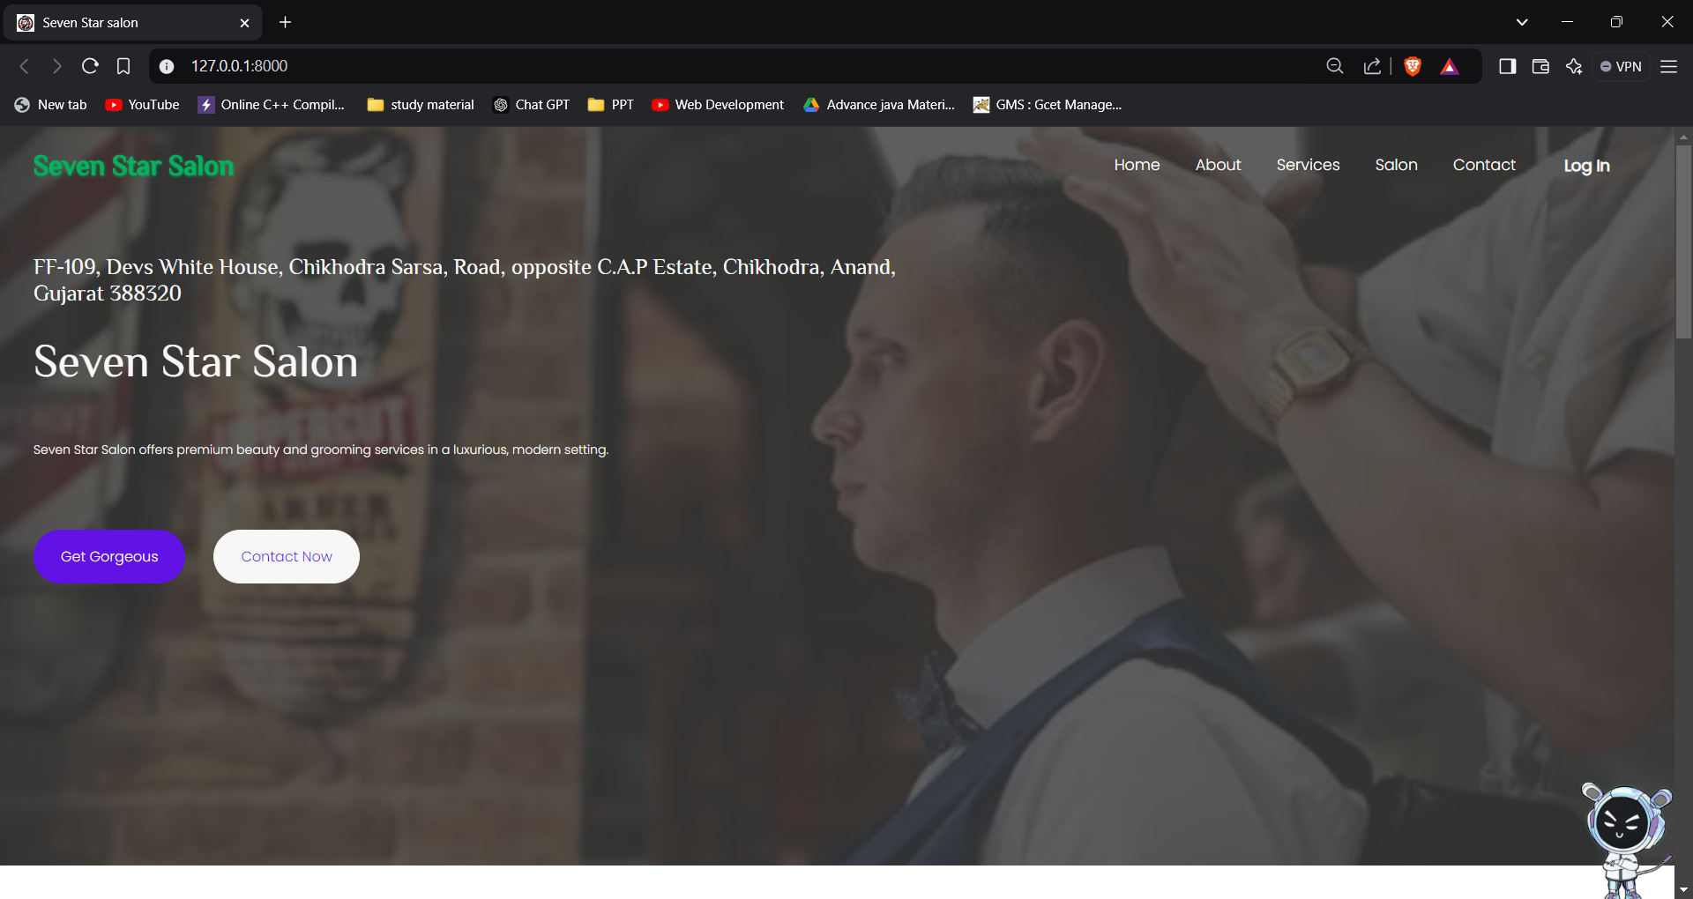
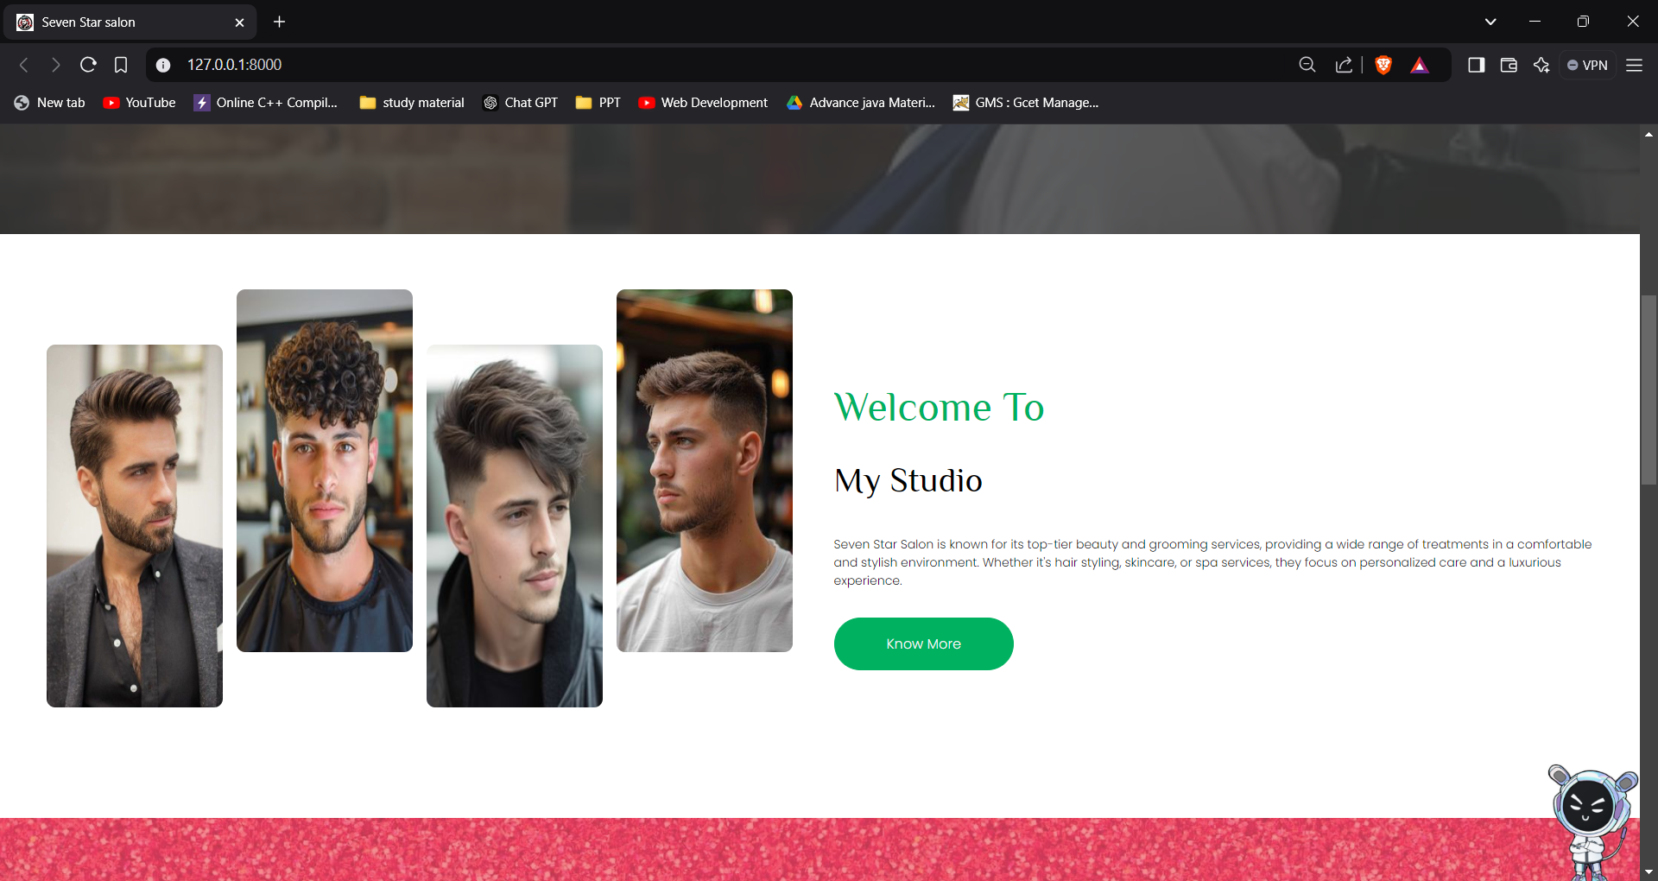
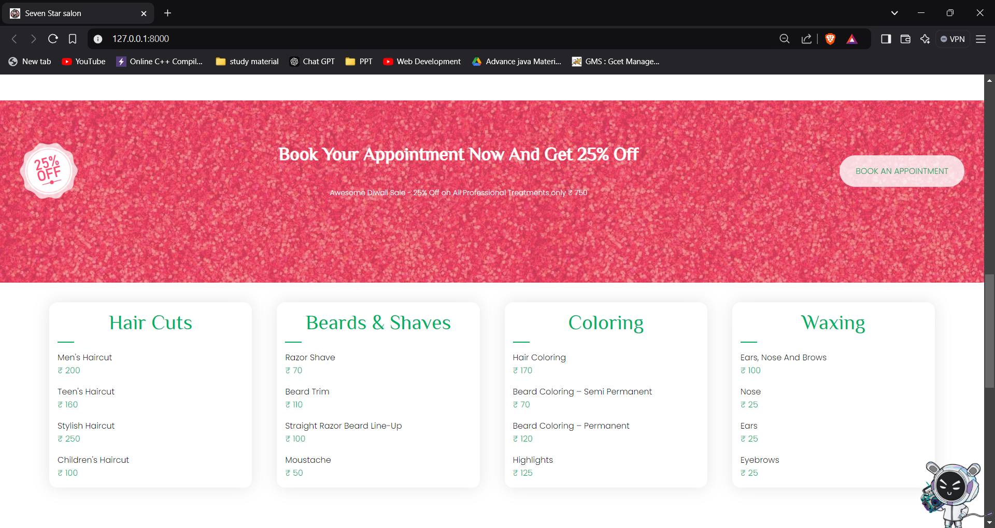
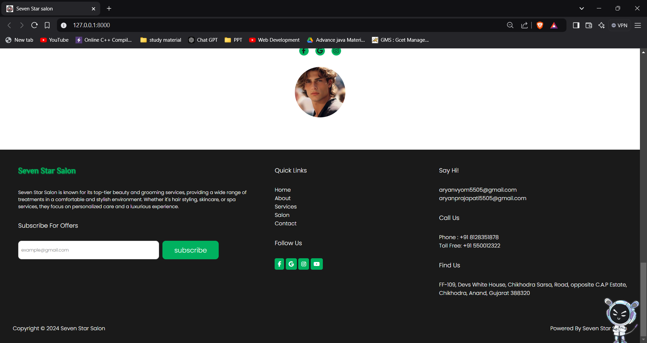
HOME PAGE
Displays a welcoming introduction to the salon, highlights key services, and invites users to explore further.

Slide 5
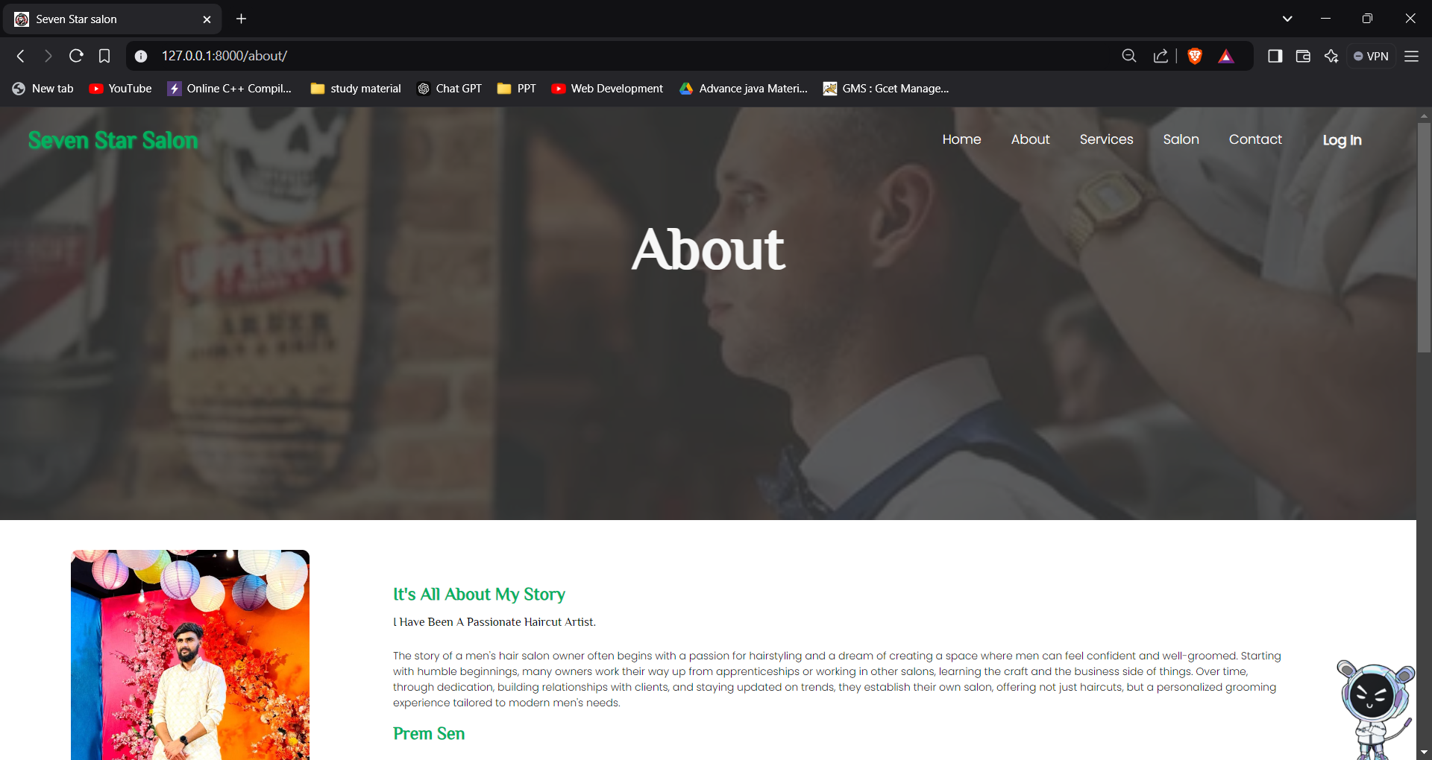
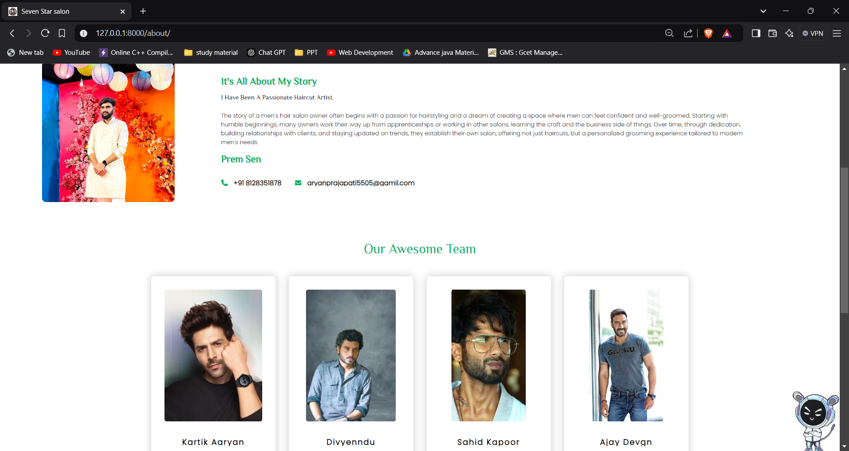
ABOUT US PAGE
Shares the salon’s story, values, and team information, giving clients a sense of trust and connection with the salon.

Slide 6
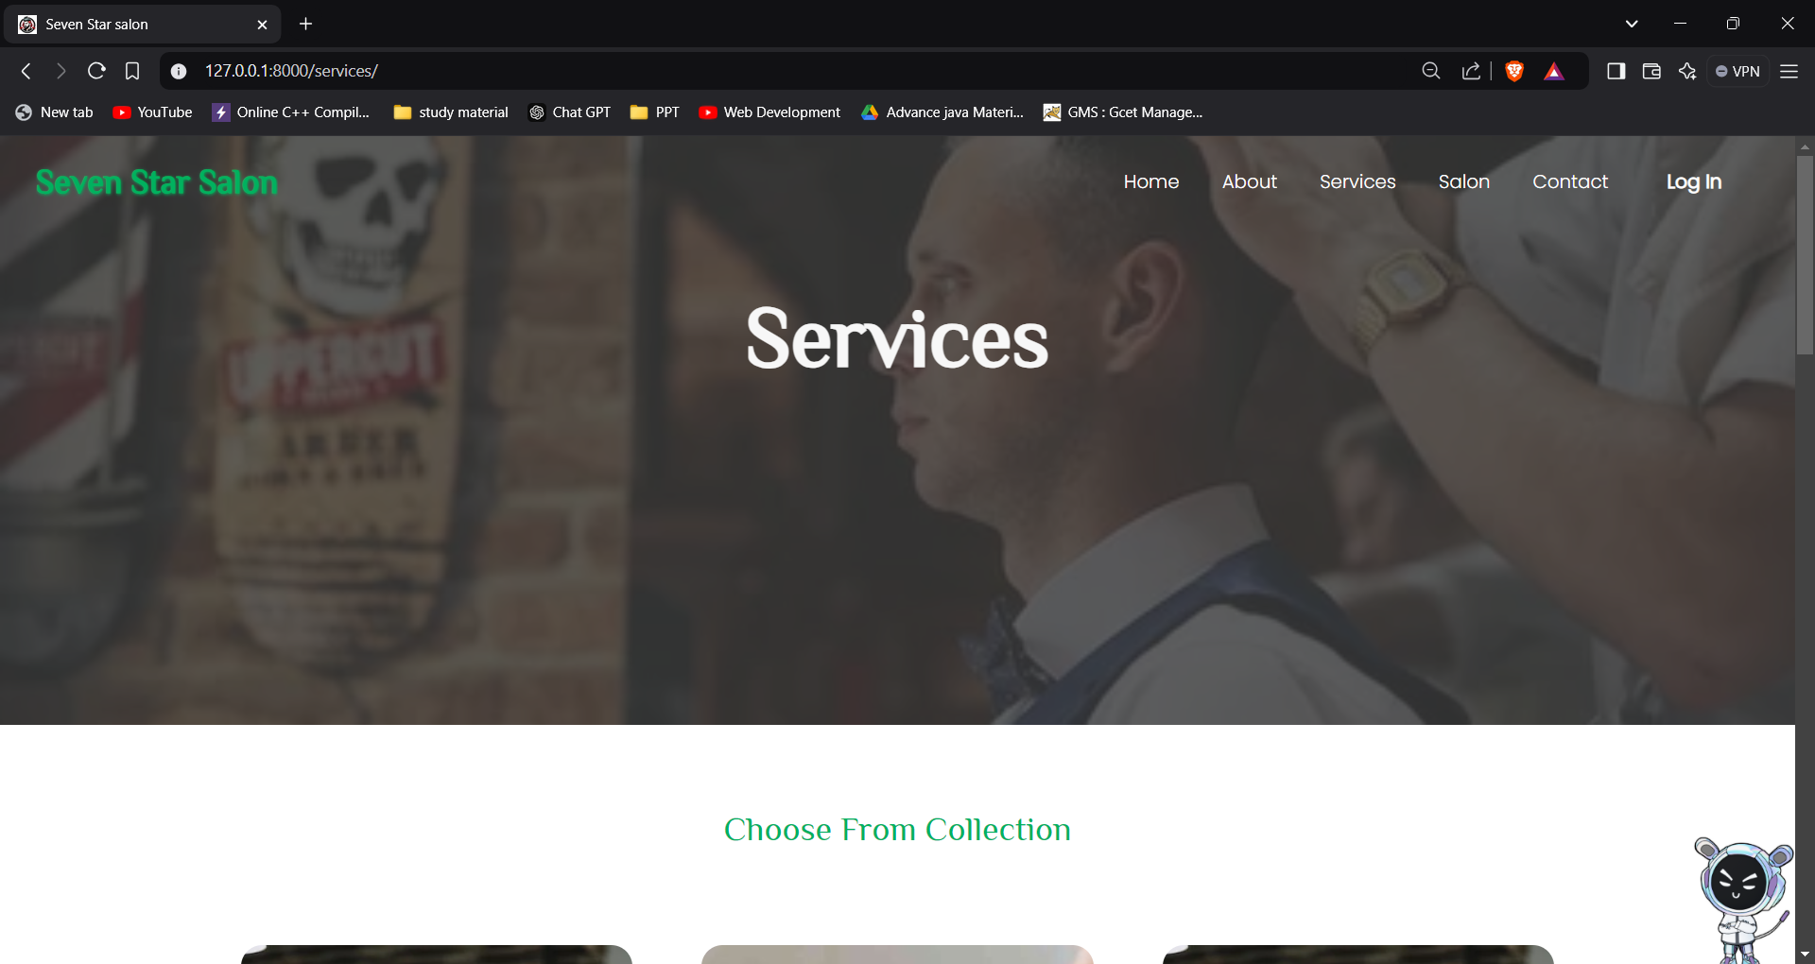
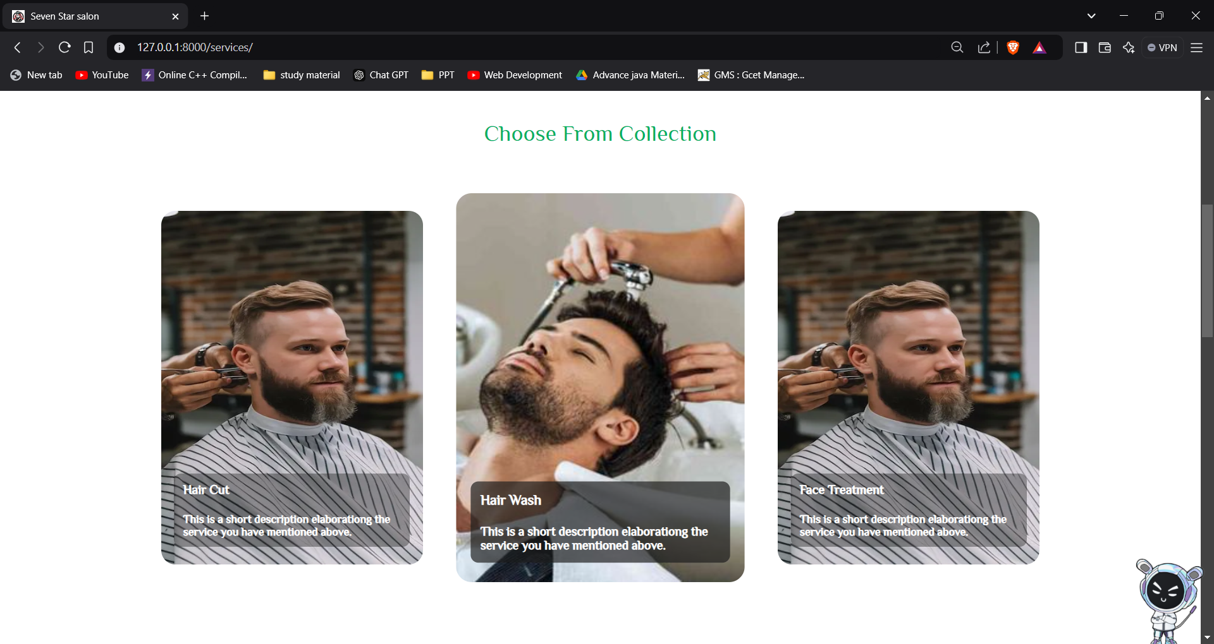
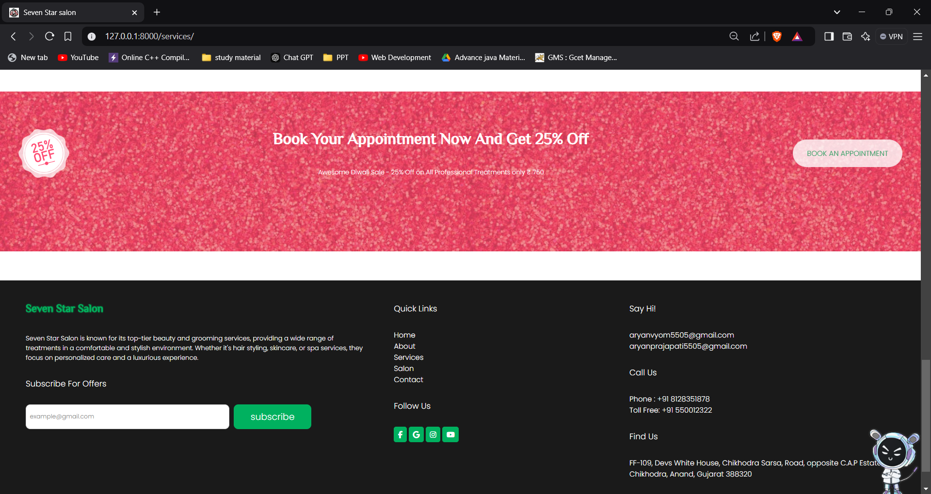
SERVICES PAGE
Displays the full list of salon services with brief descriptions, helping clients understand their options and choose the services that suit them best.

Slide 7
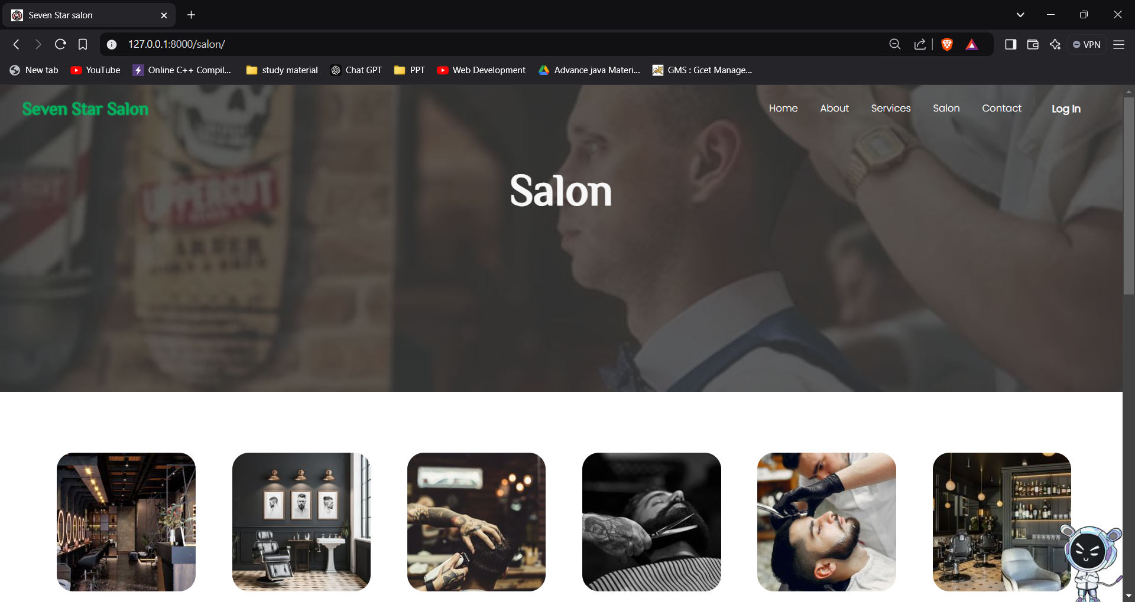
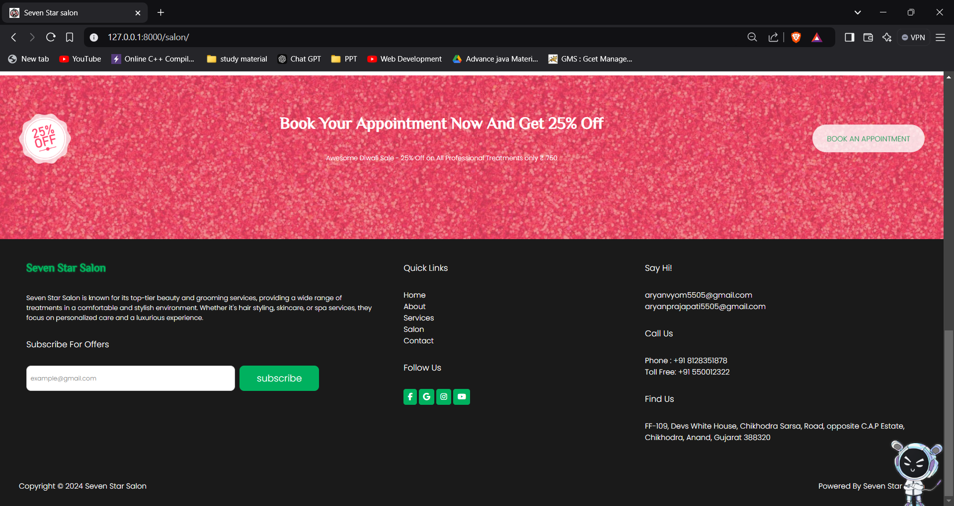
SALON PAGE
Showcases the salon’s ambiance with images, letting clients see the environment they’ll be in, building excitement and comfort.

Slide 8
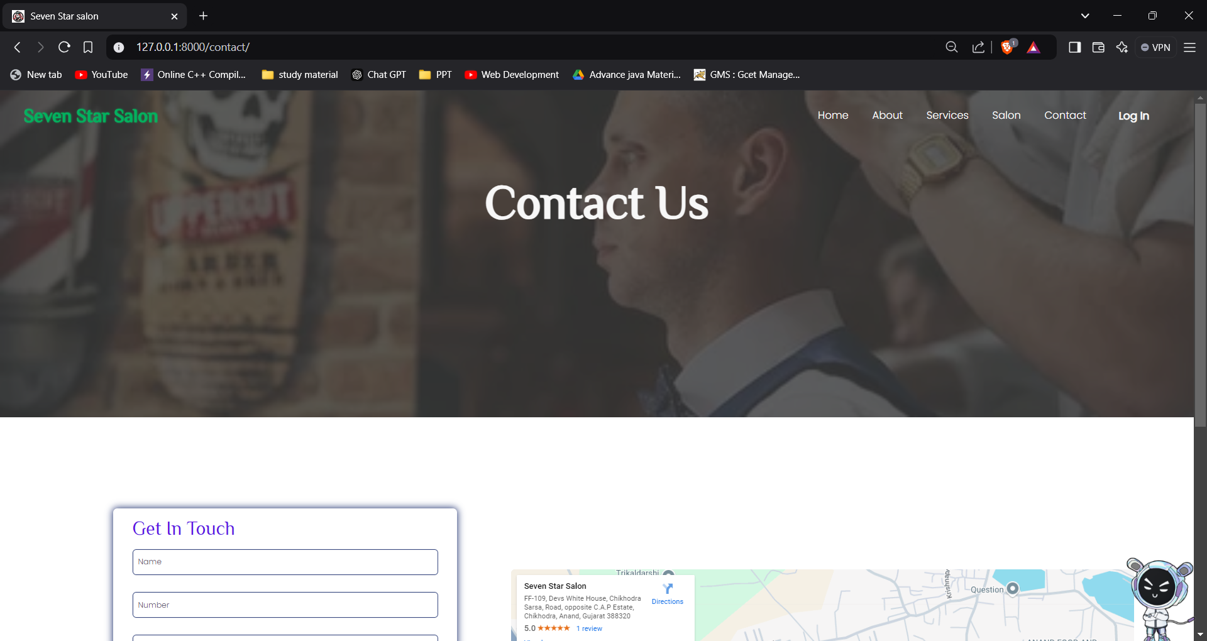
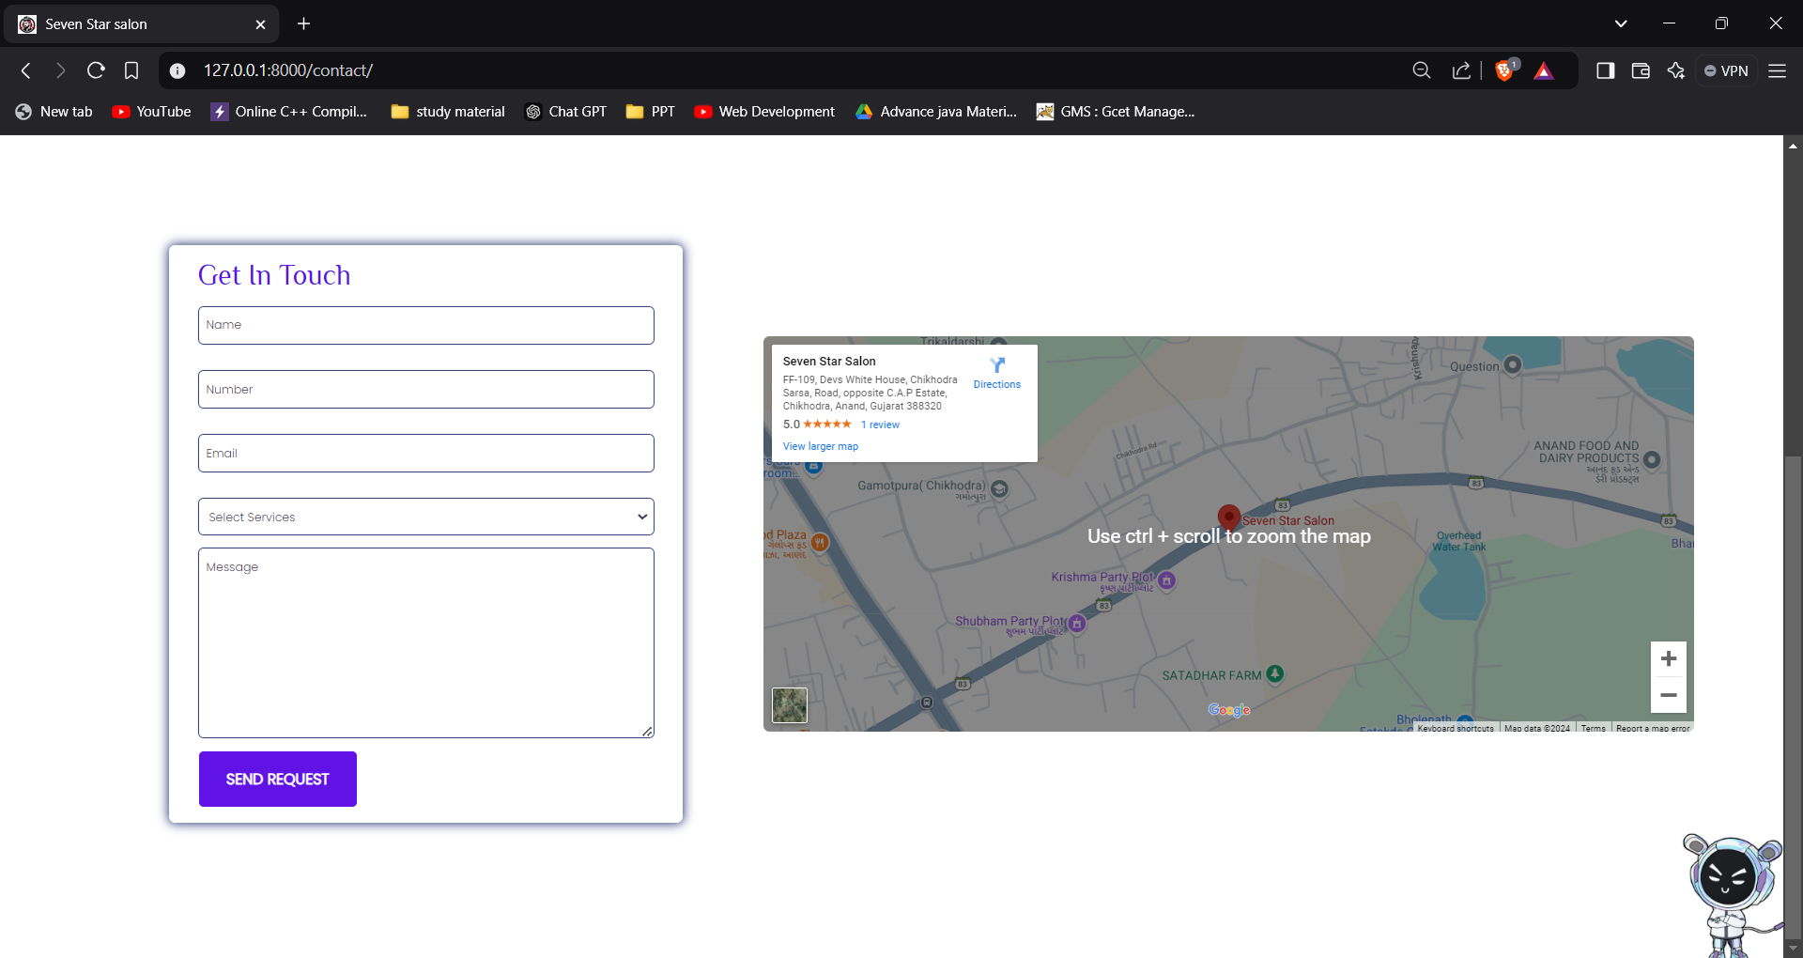
CONTACT PAGE
Provides contact details, an inquiry form, and an embedded map to help clients easily reach out or locate the salon.

Slide 9
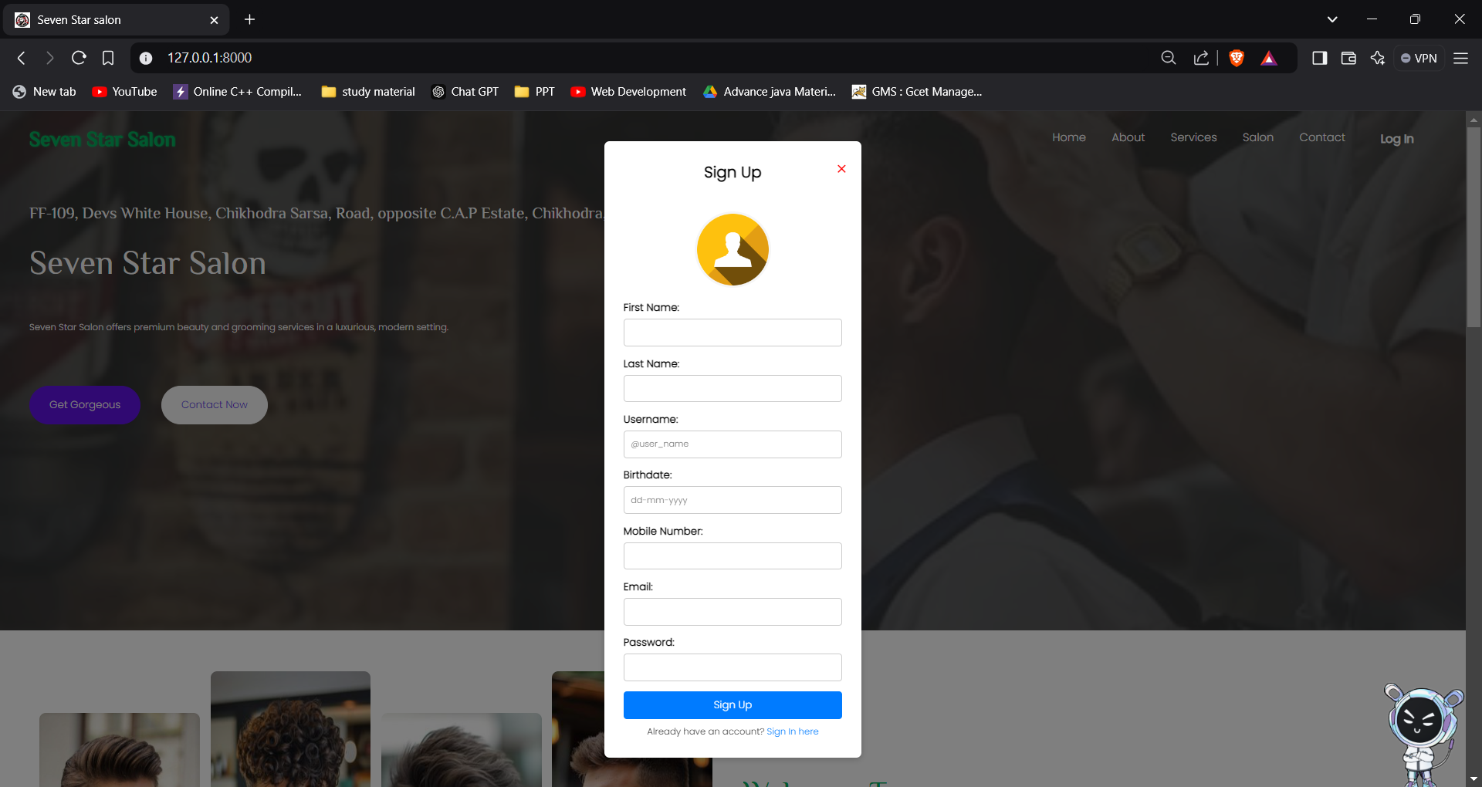
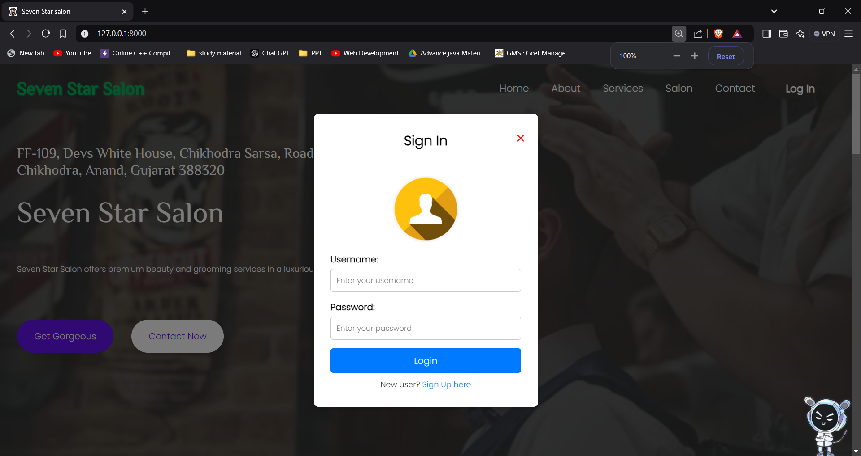
LOGIN AND SIGNUP PAGES
Allows users to create an account or sign in securely, making it easier for them to access personalized features and book services.

Slide 10
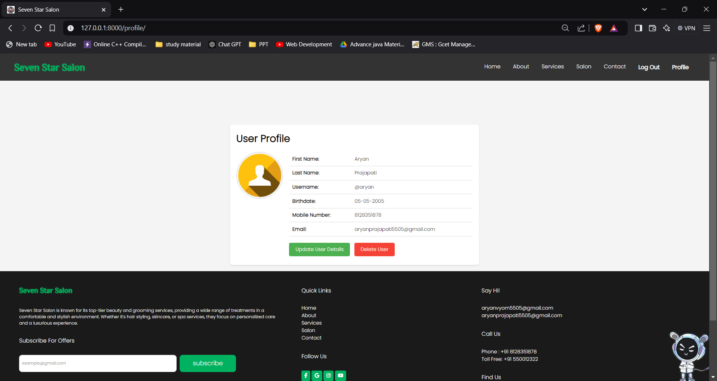
PROFILE PAGE
Lets users view and update personal details, providing a personalized and convenient experience for managing their salon interactions.

Slide 11
Thank You…

